Slide 1
Quora Duplicate Question Classifier
AML 2204
Term Project

Slide 2
Team Members
Anto Francis (C0825095)
Omer Volkan (C0831373)
Rupesh Chandran (C0826779)
Sachin Sreekumar (C0825096)

Slide 3
Introduction
Quora is a question-answering platform that lets users ask questions and get answers on them.
The most common issue which has been faced by Quora users is question duplication.
Problem Statement
Identify which questions asked on Quora are duplicates of questions that have already been asked.
Motive
This could be useful to instantly provide answers to questions that have already been answered.
Aim
Resolve this problem by applying advanced NLP techniques to classify whether questions are repeated or not.

Slide 4
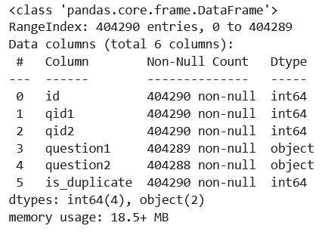
Data Collection
Data Source : https://www.kaggle.com/c/quora-question-pairs
Train.csv contains 5 columns : qid1, qid2, question1, question2, is duplicate
Size of Train.csv - 60MB
Number of rows in Train.csv = 404,290

Slide 5
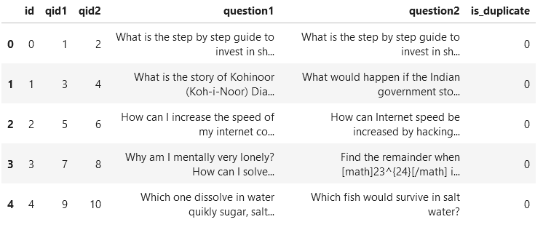
Data Collection
Data Fields
id - the id of a training set question pair
qid1, qid2 - unique ids of each question (only available in train.csv)
question1, question2 - the full text of each question
is_duplicate - the target variable, set to 1 if question1 and question2 have essentially the same meaning, and 0 otherwise.

Slide 6
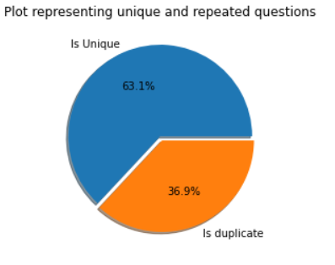
Exploratory Data Analysis
Distribution of data points among output classes

Slide 7
Basic Feature Extraction (Before cleaning)
Frequency of qid1's
Frequency of qid2's
Length of q1
Length of q2
Number of words in Question 1
Number of words in Question 2
Number of common unique words in Question 1 and Question 2
Total words (Total numbers of words in Question 1 and 2)
Word share (word_common/word_Total)
sum total of frequency of qid1 and qid2
Absolute difference of frequency of qid1 and qid2

Slide 8
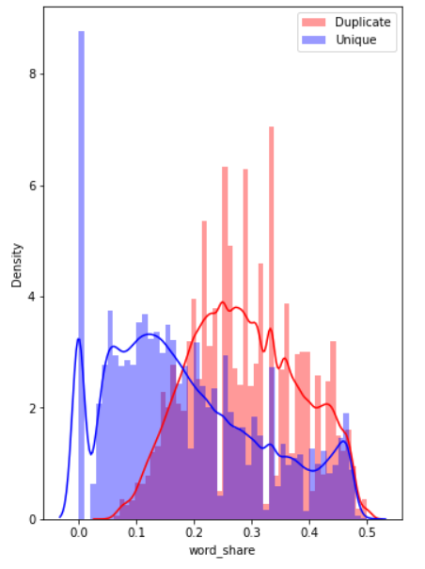
Analysis of some of the extracted features
The distributions for normalized word_share have some overlap on the far right-hand side, i.e., there are quite a lot of questions with high word similarity
The average word share and Common no. of words of qid1 and qid2 is more when they are duplicate(Similar)

Slide 9
Analysis of some of the extracted features
Here are some questions have only one single words.
Minimum length of the questions in question1 : 1
Minimum length of the questions in question2 : 1
Number of Questions with minimum length [question1] : 67
Number of Questions with minimum length [question2] : 24

Slide 10
Preprocessing of Text
Removing html tags
<div> <h1>Title</h1> <p></p> </a> </div>
Removing Punctuations
, ‘ “” ? - _ : ;
Performing stemming
Reduced to word’s base form using PorterStemmer()
Removing Stopwords
Removed common words using WordCloud’s STOPWORD
Expanding contractions
Expanded short forms of words by replacing them with the help of RegEx

Slide 11
Advanced Feature Extraction (NLP and Fuzzy Features)
Some of the features further extracted:
Ratio of common word count to min & max length of word count of Q1 and Q2
Check if first & last word of both questions is same or not
Absolute length difference
Average token length of both questions
Fuzz Ratio: Similarity between strings in the given state
Fuzz Partial Ratio: Similarity between strings partially
Token sort ratio: Similarity between strings out of order.
Token set ratio: Similarity between strings using intersections

Slide 12
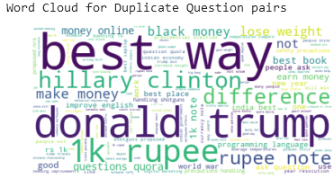
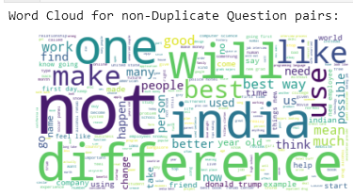
Analysis of extracted features
Total number of words in duplicate pair questions : 16110763 Total number of words in non duplicate pair questions : 33201102
Total number of words in duplicate pair questions : 16110763
Total number of words in non duplicate pair questions : 33201102

Slide 13
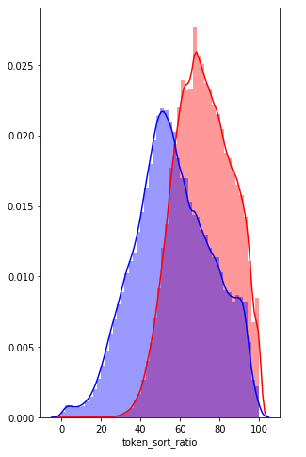
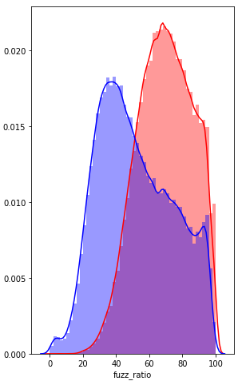

Analysis of extracted features
Distribution plot of duplicate questions and token sort ratio
Distribution plot of duplicate questions and fuzz ratio

Slide 14
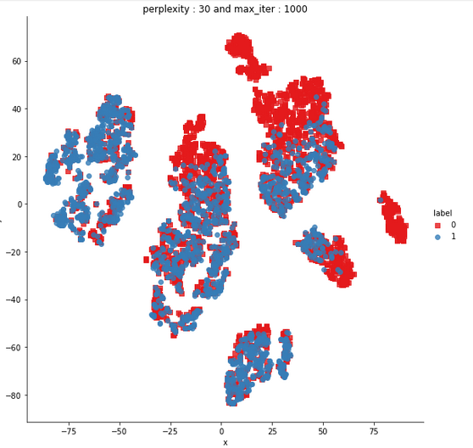
Analysis of extracted features
Using TSNE for Dimentionality reduction for 15 Features

Slide 15
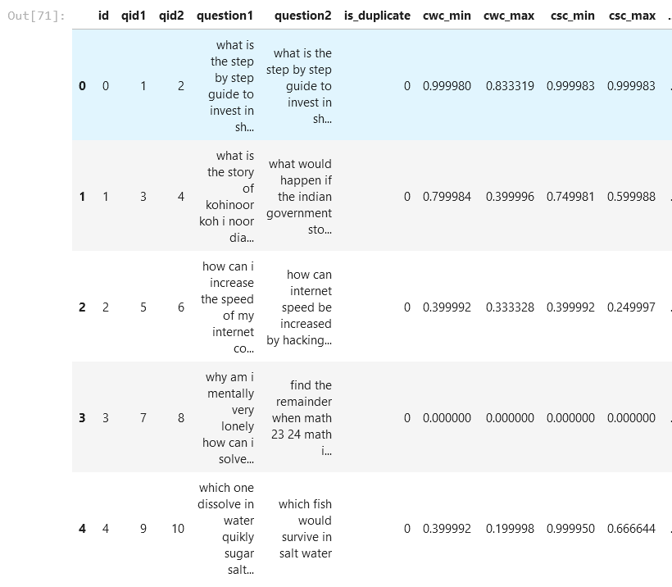
Modeling on TFIDF vectorizer

Slide 16
Pre-Processing Data for Model Training
Check for null values
Dropped three rows with null values.
Target specified as ‘is_duplicate’ as it is the dependent value
Randomly split the data into train and split of ratio 70:30
Vectorized and combined question 1 and question 2
Checked class distribution in train and test data

Slide 17
Machine Learning Models
Random model
Logistic Regression with hyperparameter tuning
Linear SVM with hyperparameter tuning
Random Forest
XGBoost
With Tf-idf features

Slide 18
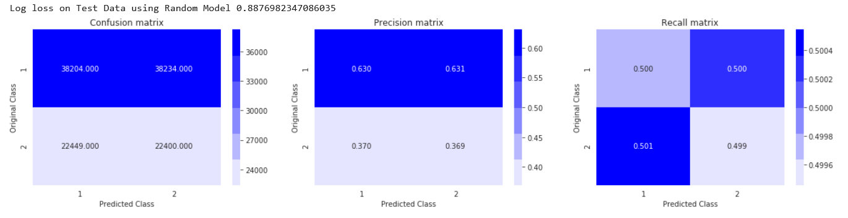
Random model

Slide 19
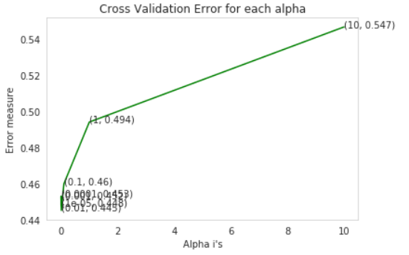
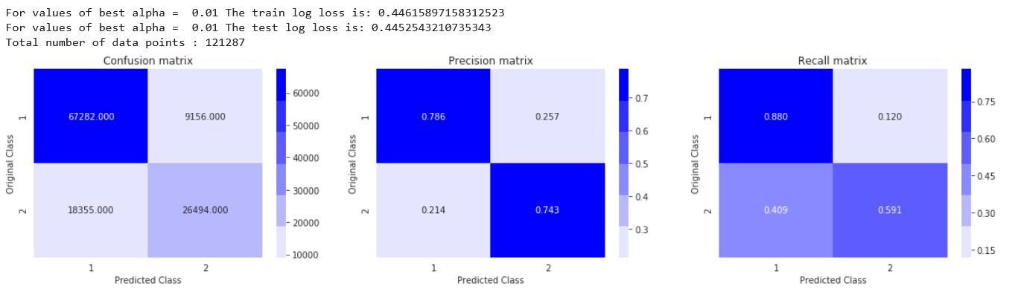
Logistic Regression
SGDClassifier

Slide 20
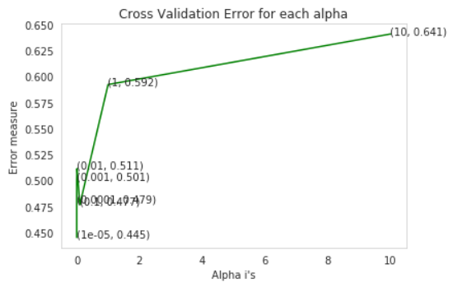

Linear SVM

Slide 21
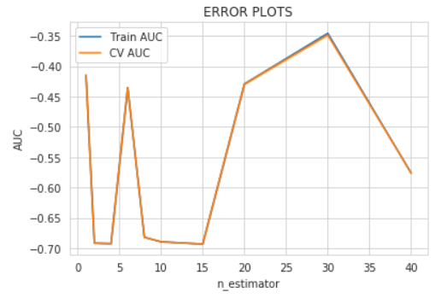
Plotting hyperparamater: n_estimator vs AUC

Slide 22
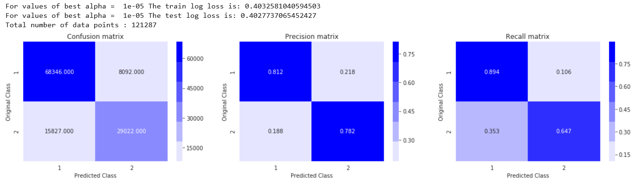
XGBoost
The test log loss is: 0.32395333663854076
XGBClassifier
With best n_estimator and learning rate hyperparameter

Slide 23
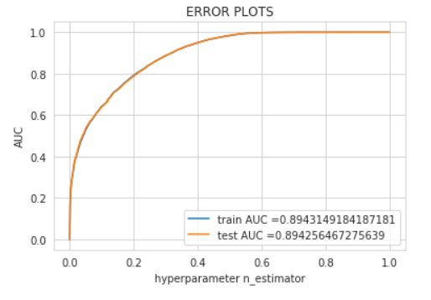
Plotting roc curve

Slide 24
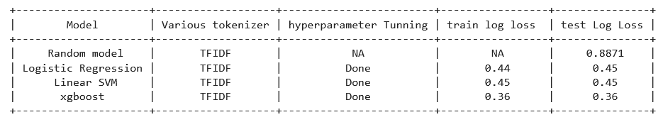
Conclusion

Slide 25
Thank You!

